Slide 1
Culture Hour: A Brief History of Hacking
Meghan Clark
24 Nov 2014

Slide 2
The Phreaks
Phone Phreaks of America vs. Ma Bell

Slide 3
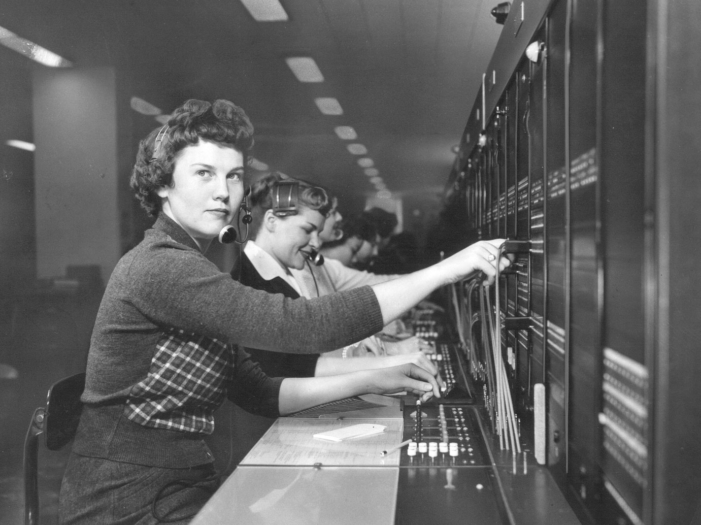
Notes:
Omaha, http://www.telcomhistory.org/images/main/11%20-%20omaha.jpg Before the 1940s and 50s, this was how you did it.

Slide 4
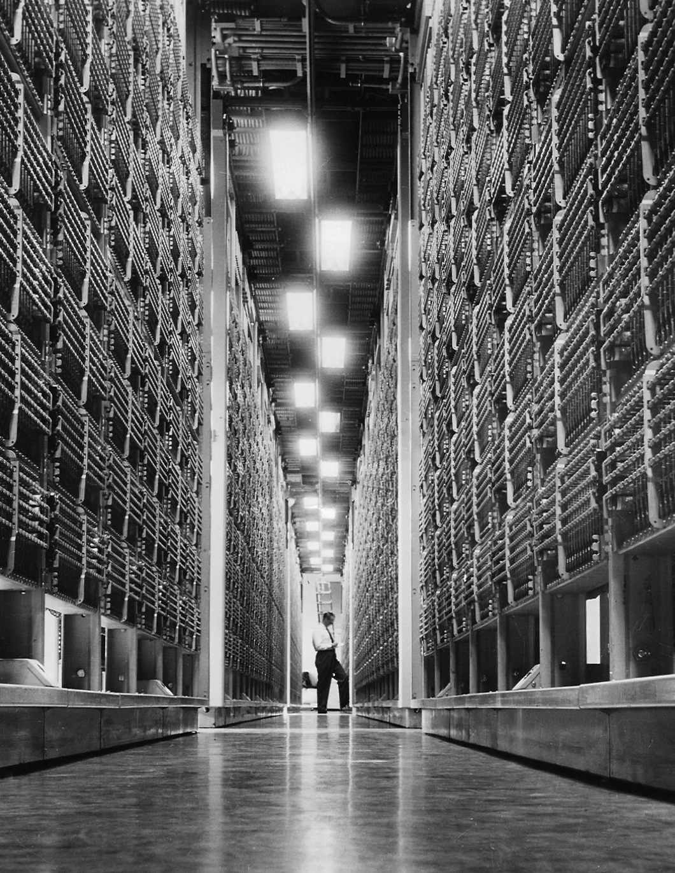
Notes:
IEEE http://www.ieeeghn.org/wiki/index.php/File:-4A_Toll_Crossbar_1955.jpg
1955 4A crossbar
LDD machines were designed w/o benefit of transistor, which was invented in 1947 (at Bell Labs).

Slide 5
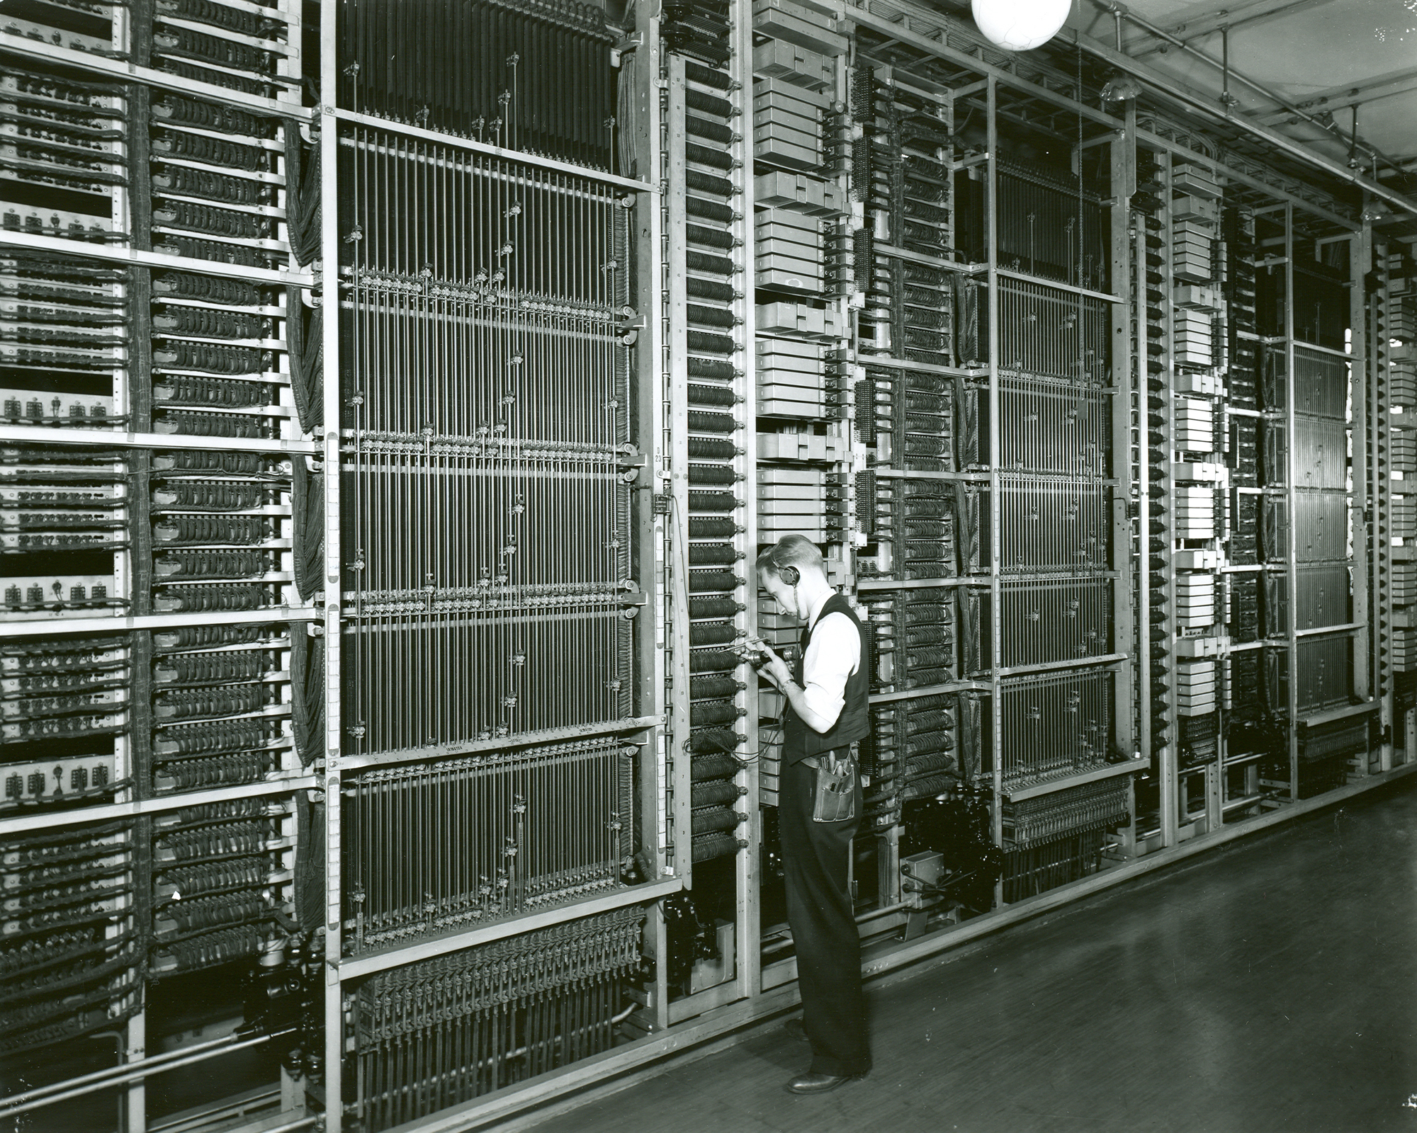
Notes:
Started installing in 1940s. Almost 200 of these installed by 1976. worked by punch card – first six digits selected punch card, card determined routing

Slide 6
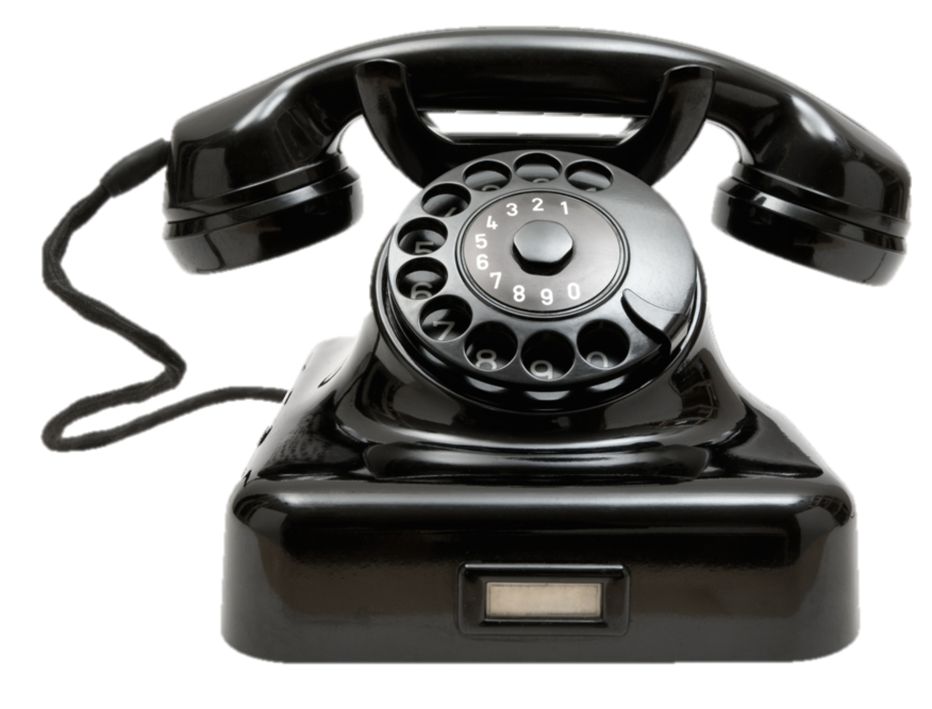
The Bell System
#4A crossbar switch
2600 Hz
#4A crossbar switch
2600 Hz
Seattle
New York
Notes:
Trunk lines running between them

Slide 7
The Bell System
#4A crossbar switch
2600 Hz
#4A crossbar switch
2600 Hz
Seattle
New York
Notes:
Trunk lines running between them

Slide 8
The Bell System
#4A crossbar switch
#4A crossbar switch
2600 Hz
Seattle
New York
“I want to place a call!”
Notes:
Trunk lines running between them

Slide 9
The Bell System
#4A crossbar switch
#4A crossbar switch
2600 Hz “wink”
Seattle
New York
“Go ahead”
Notes:
Trunk lines running between them

Slide 10
The Bell System
#4A crossbar switch
<digit tones>
#4A crossbar switch
2600 Hz
Seattle
New York
“Here’s the number”
Notes:
Trunk lines running between them

Slide 11
The Bell System
#4A crossbar switch
#4A crossbar switch
2600 Hz
Seattle
New York
Notes:
Trunk lines running between them

Slide 12
The Bell System
#4A crossbar switch
<call>
#4A crossbar switch
2600 Hz
Seattle
New York
Notes:
Trunk lines running between them

Slide 13
The Bell System
#4A crossbar switch
2600 Hz
#4A crossbar switch
2600 Hz
Seattle
New York
“Call finished.”
Notes:
Trunk lines running between them

Slide 14
The Bell System
#4A crossbar switch
2600 Hz
#4A crossbar switch
2600 Hz
Seattle
New York
Notes:
Trunk lines running between them

Slide 15
Ralph Barclay
Age: 18
School: Washington State College
Class: Freshman
Notes: Electronics tinkerer. Lived in dorm with many engineers.
Notes:
Year: 1960

Slide 16
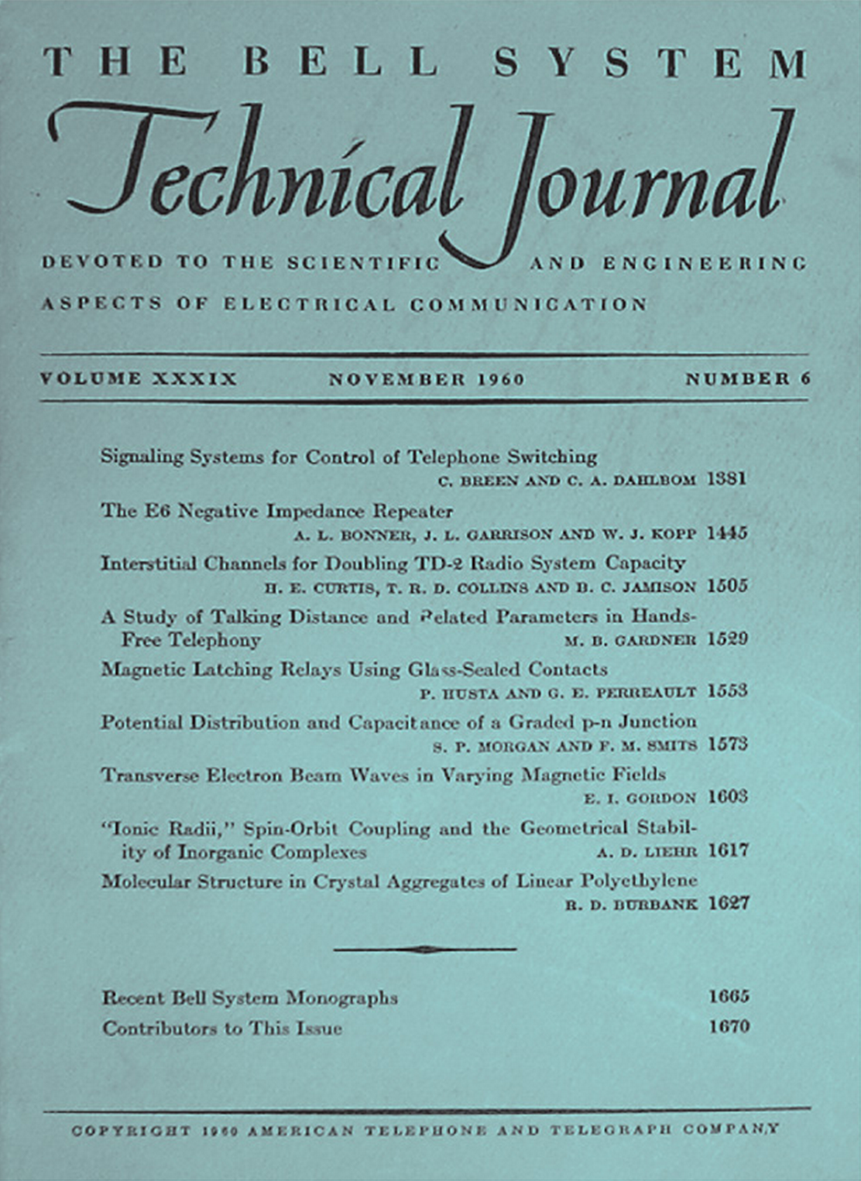
Notes:
The journal!! Phil Lapsley

Slide 17
#4A crossbar switch
2600 Hz
#4A crossbar switch
2600 Hz
Seattle
New York
Notes:
Trunk lines running between them

Slide 18
Directory Assistance
#4A crossbar switch
2600 Hz
#4A crossbar switch
2600 Hz
Seattle
New York
Notes:
Trunk lines running between them

Slide 19
Directory Assistance
#4A crossbar switch
2600 Hz
#4A crossbar switch
2600 Hz
Seattle
New York
Notes:
Trunk lines running between them

Slide 20
Directory Assistance
#4A crossbar switch
#4A crossbar switch
2600 Hz
Seattle
New York
Notes:
Trunk lines running between them

Slide 21
Directory Assistance
#4A crossbar switch
#4A crossbar switch
2600 Hz wink
Seattle
New York
Notes:
Trunk lines running between them

Slide 22
Directory Assistance
#4A crossbar switch
<digit tones>
#4A crossbar switch
2600 Hz
Seattle
New York
Notes:
Trunk lines running between them

Slide 23
Directory Assistance
#4A crossbar switch
#4A crossbar switch
2600 Hz
Seattle
New York
Notes:
Trunk lines running between them

Slide 24
Directory Assistance
2600 Hz
#4A crossbar switch
#4A crossbar switch
2600 Hz
Seattle
New York
Notes:
Trunk lines running between them

Slide 25
Directory Assistance
2600 Hz
#4A crossbar switch
2600 Hz
#4A crossbar switch
2600 Hz
Seattle
New York
Notes:
Trunk lines running between them

Slide 26
Directory Assistance
2600 Hz
#4A crossbar switch
2600 Hz
#4A crossbar switch
2600 Hz
Seattle
New York
Notes:
Trunk lines running between them

Slide 27
Directory Assistance
#4A crossbar switch
2600 Hz
#4A crossbar switch
2600 Hz
Seattle
New York
Notes:
Trunk lines running between them

Slide 28
Directory Assistance
#4A crossbar switch
#4A crossbar switch
2600 Hz
Seattle
New York
Notes:
Trunk lines running between them

Slide 29
Directory Assistance
#4A crossbar switch
#4A crossbar switch
2600 Hz wink
Seattle
New York
Notes:
Trunk lines running between them

Slide 30
Directory Assistance
2600 Hz wink
#4A crossbar switch
#4A crossbar switch
2600 Hz wink
Seattle
New York
Notes:
Trunk lines running between them

Slide 31
Directory Assistance
#4A crossbar switch
#4A crossbar switch
2600 Hz
Seattle
New York
Notes:
Trunk lines running between them

Slide 32
Directory Assistance
<digit tones>
#4A crossbar switch
#4A crossbar switch
2600 Hz
Seattle
New York
Notes:
Trunk lines running between them

Slide 33
Directory Assistance
<digit tones>
#4A crossbar switch
<digit tones>
#4A crossbar switch
2600 Hz
Seattle
New York
Notes:
Trunk lines running between them

Slide 34
Directory Assistance
#4A crossbar switch
#4A crossbar switch
2600 Hz
Seattle
New York
Notes:
Trunk lines running between them

Slide 35
Directory Assistance
#4A crossbar switch
#4A crossbar switch
2600 Hz
Seattle
New York
Notes:
Trunk lines running between them

Slide 36
Directory Assistance
Free call to Directory Assistance
#4A crossbar switch
#4A crossbar switch
2600 Hz
Seattle
New York
Notes:
Trunk lines running between them

Slide 37
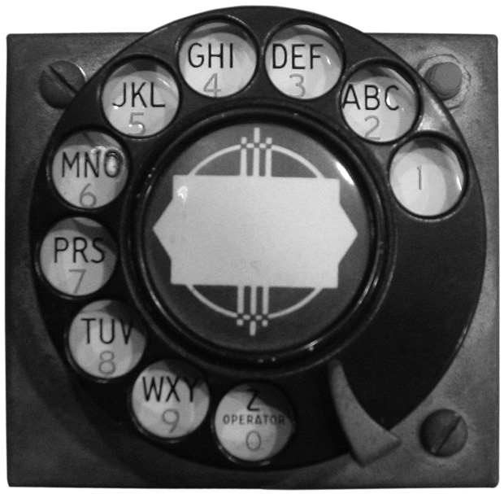
Notes:
A few weeks later went home and soldered together single transistor oscillator and rotary dial. Red button seizes trunk line, dial sends pulses.
Barclay’s Blue Box. IEEE Spectrum. http://spectrum.ieee.org/img/phone01_620px-1358880875676.jpg

Slide 38
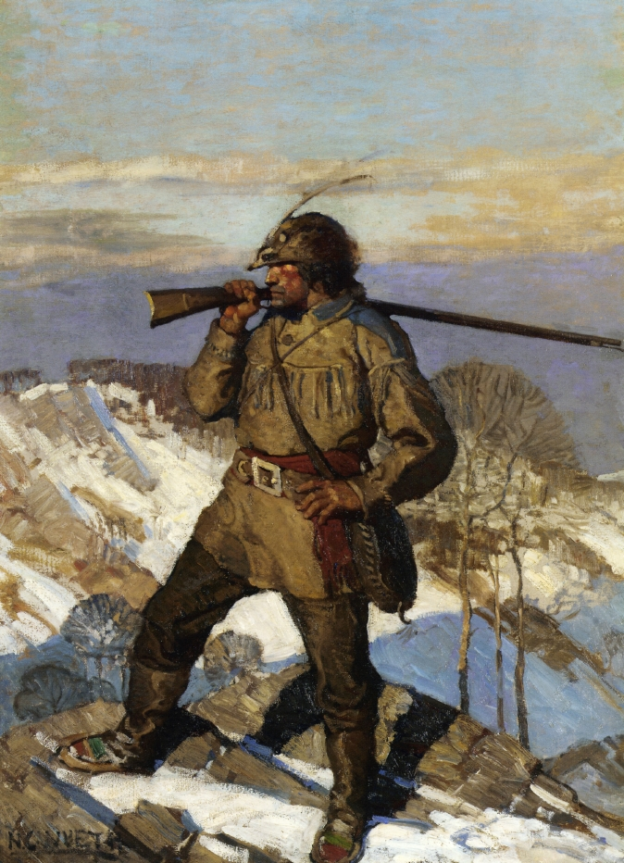
Notes:
Started exploring phone network. Friends photography studio a couple blocks from his summer job.
http://www.the-athenaeum.org/art/display_image.php?id=56692

Slide 39

Notes:
Sheriff, FBI, Bell Labs engineer
Non-working directory assistance number printed out trouble cards. Went from getting 20 calls a month to 200 calls a month after April 1961. Thought it might be a bookie. Tracked back to photography studio, where guy made lots of calls about horses. Arrested them both.
Bell Labs guy confirmed that most of the numbers Ralph dialed were test, recordings, internal numbers – very few to real people. Also confirmed that they published that article.

Slide 40
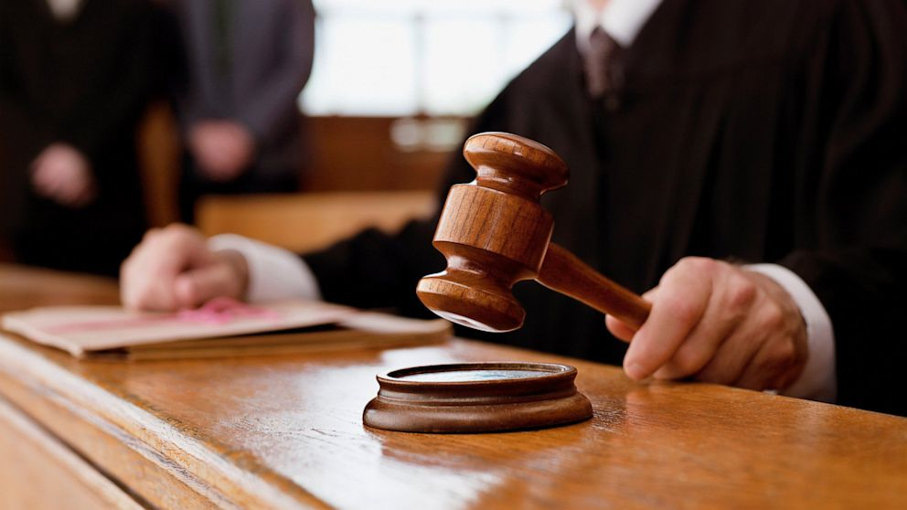

Slide 41


Slide 42
Chris Pyne
Age: 18 (troublemaker since 15)
Hometown: Marblehead, MA
High school: Governor Drummer Academy
College: Harvard University
Extracurriculars: WHRB Radio
Accomplices: Rick Turner(Harvard), Paul Heckel (MIT), Tony Lauck (Harvard), Ed Ross (Harvard)
Notes: Ham radio enthusiast.

Slide 43
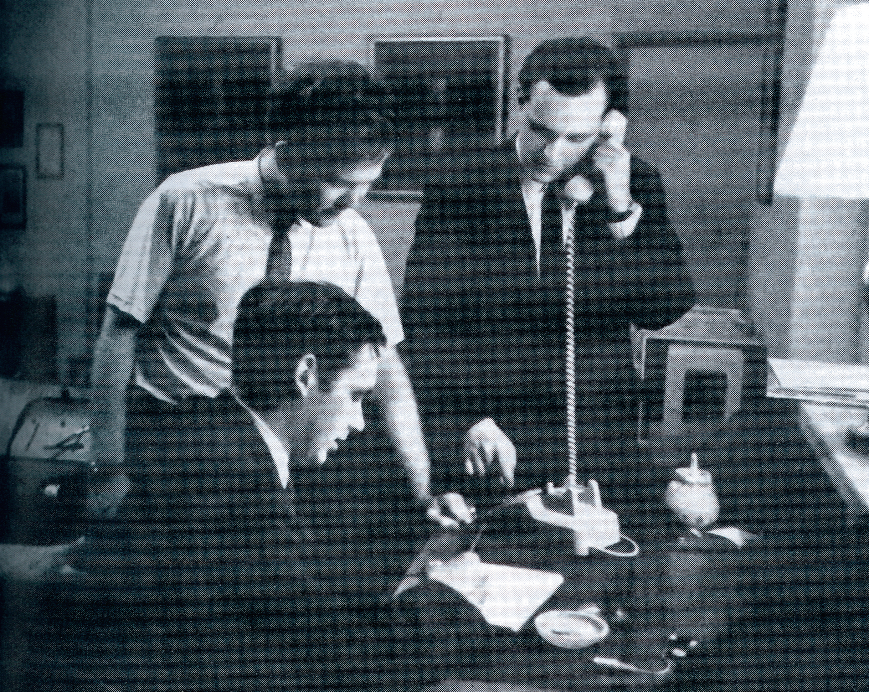
Notes:
Discovered blue box, black box. Had MIT student build them.
Could tie up all the tie lines between harvard and MIT. MIT > Lincoln labs > MITRE > IBM Kingston > Stewart AFB. Hanscom AFB, NIKE control, control site for new england misile defense system
Mapped out network.
Called president of mexico at 2 am, were told he was in bed.

Slide 44
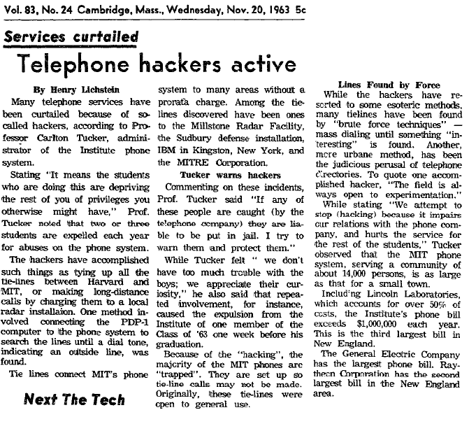
Notes:
Got caught because they lent the notebook they were using to record everything to a guy who worked for the telephone company.
FBI interviewed them, convinced they weren’t soviet spies.
AT&T didn’t want to prosecute, made them write 40 page essay and destroy the boxes.
Had to take a year off of Harvard.
First known usage of word “Hacker” in the negative sense
http://duartes.org/gustavo/blog/post/first-recorded-usage-of-hacker/

Slide 45
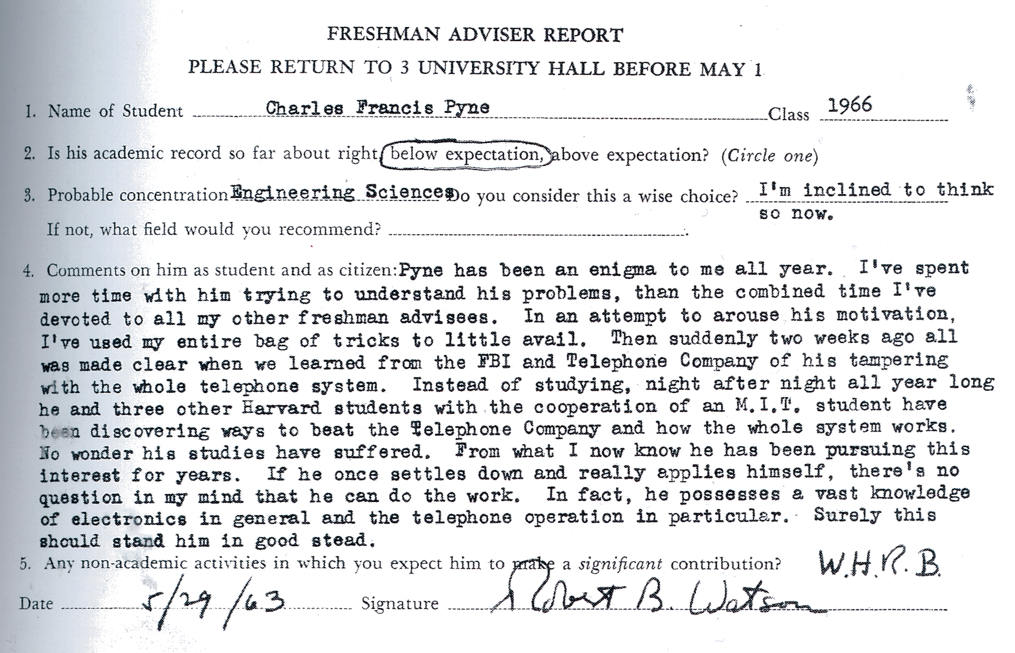

Slide 46
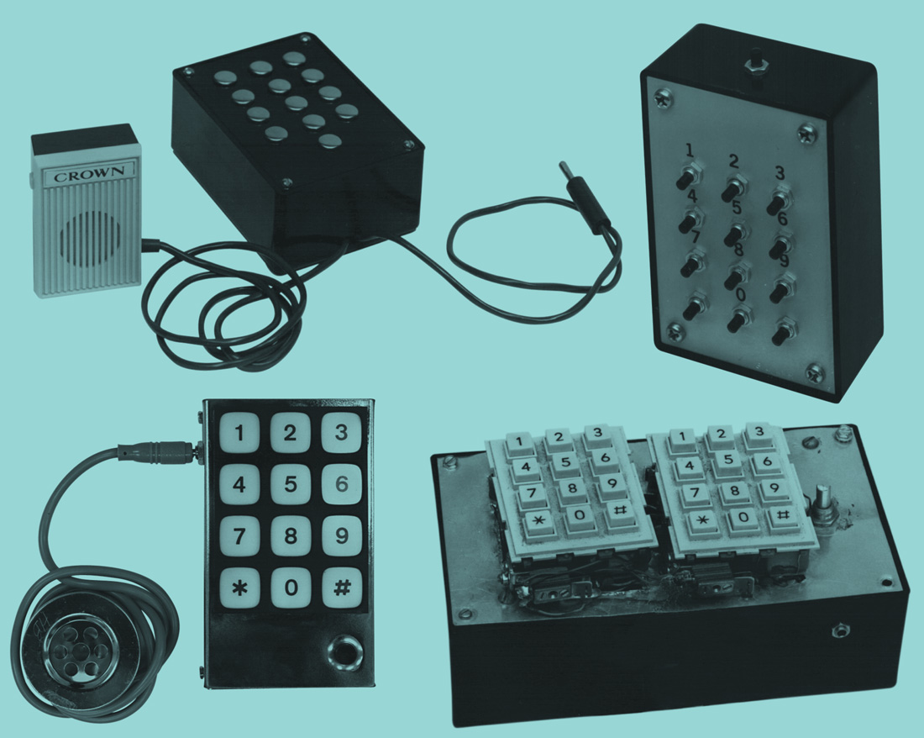
Things Get Real
Notes:
Ed Turnley. Collection of 1970’s blue boxes

Slide 47
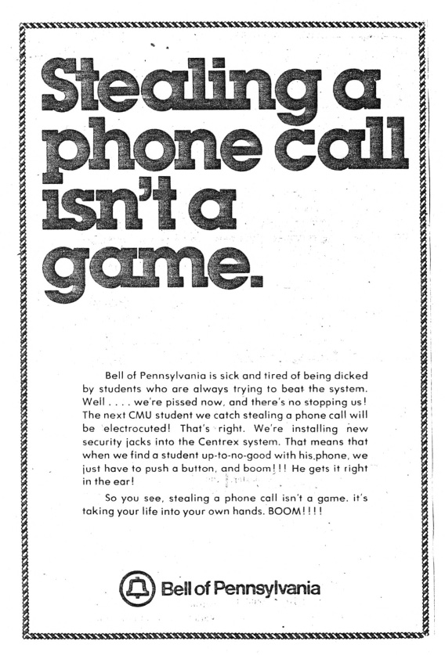

Slide 48
AT&T’s Problem
Prosecuting kids inadvisable
Bad publicity
Spreads awareness of vuln
Network upgrade will take decades and $$
Not even sure how bad the problem is

Slide 49
Project Greenstar
Began in 1964
First known instance of mass surveillance
Monitored ~33 million calls
Recorded 1.5 million calls
Notes:
Six units – 2 in LA, Miami, 2 in NY the one moved to Newark, one in Detroit then moved to St. Louis
Ended 1970
25,000 cases of known illegality
Estimated 350,000 nationwide

Slide 50
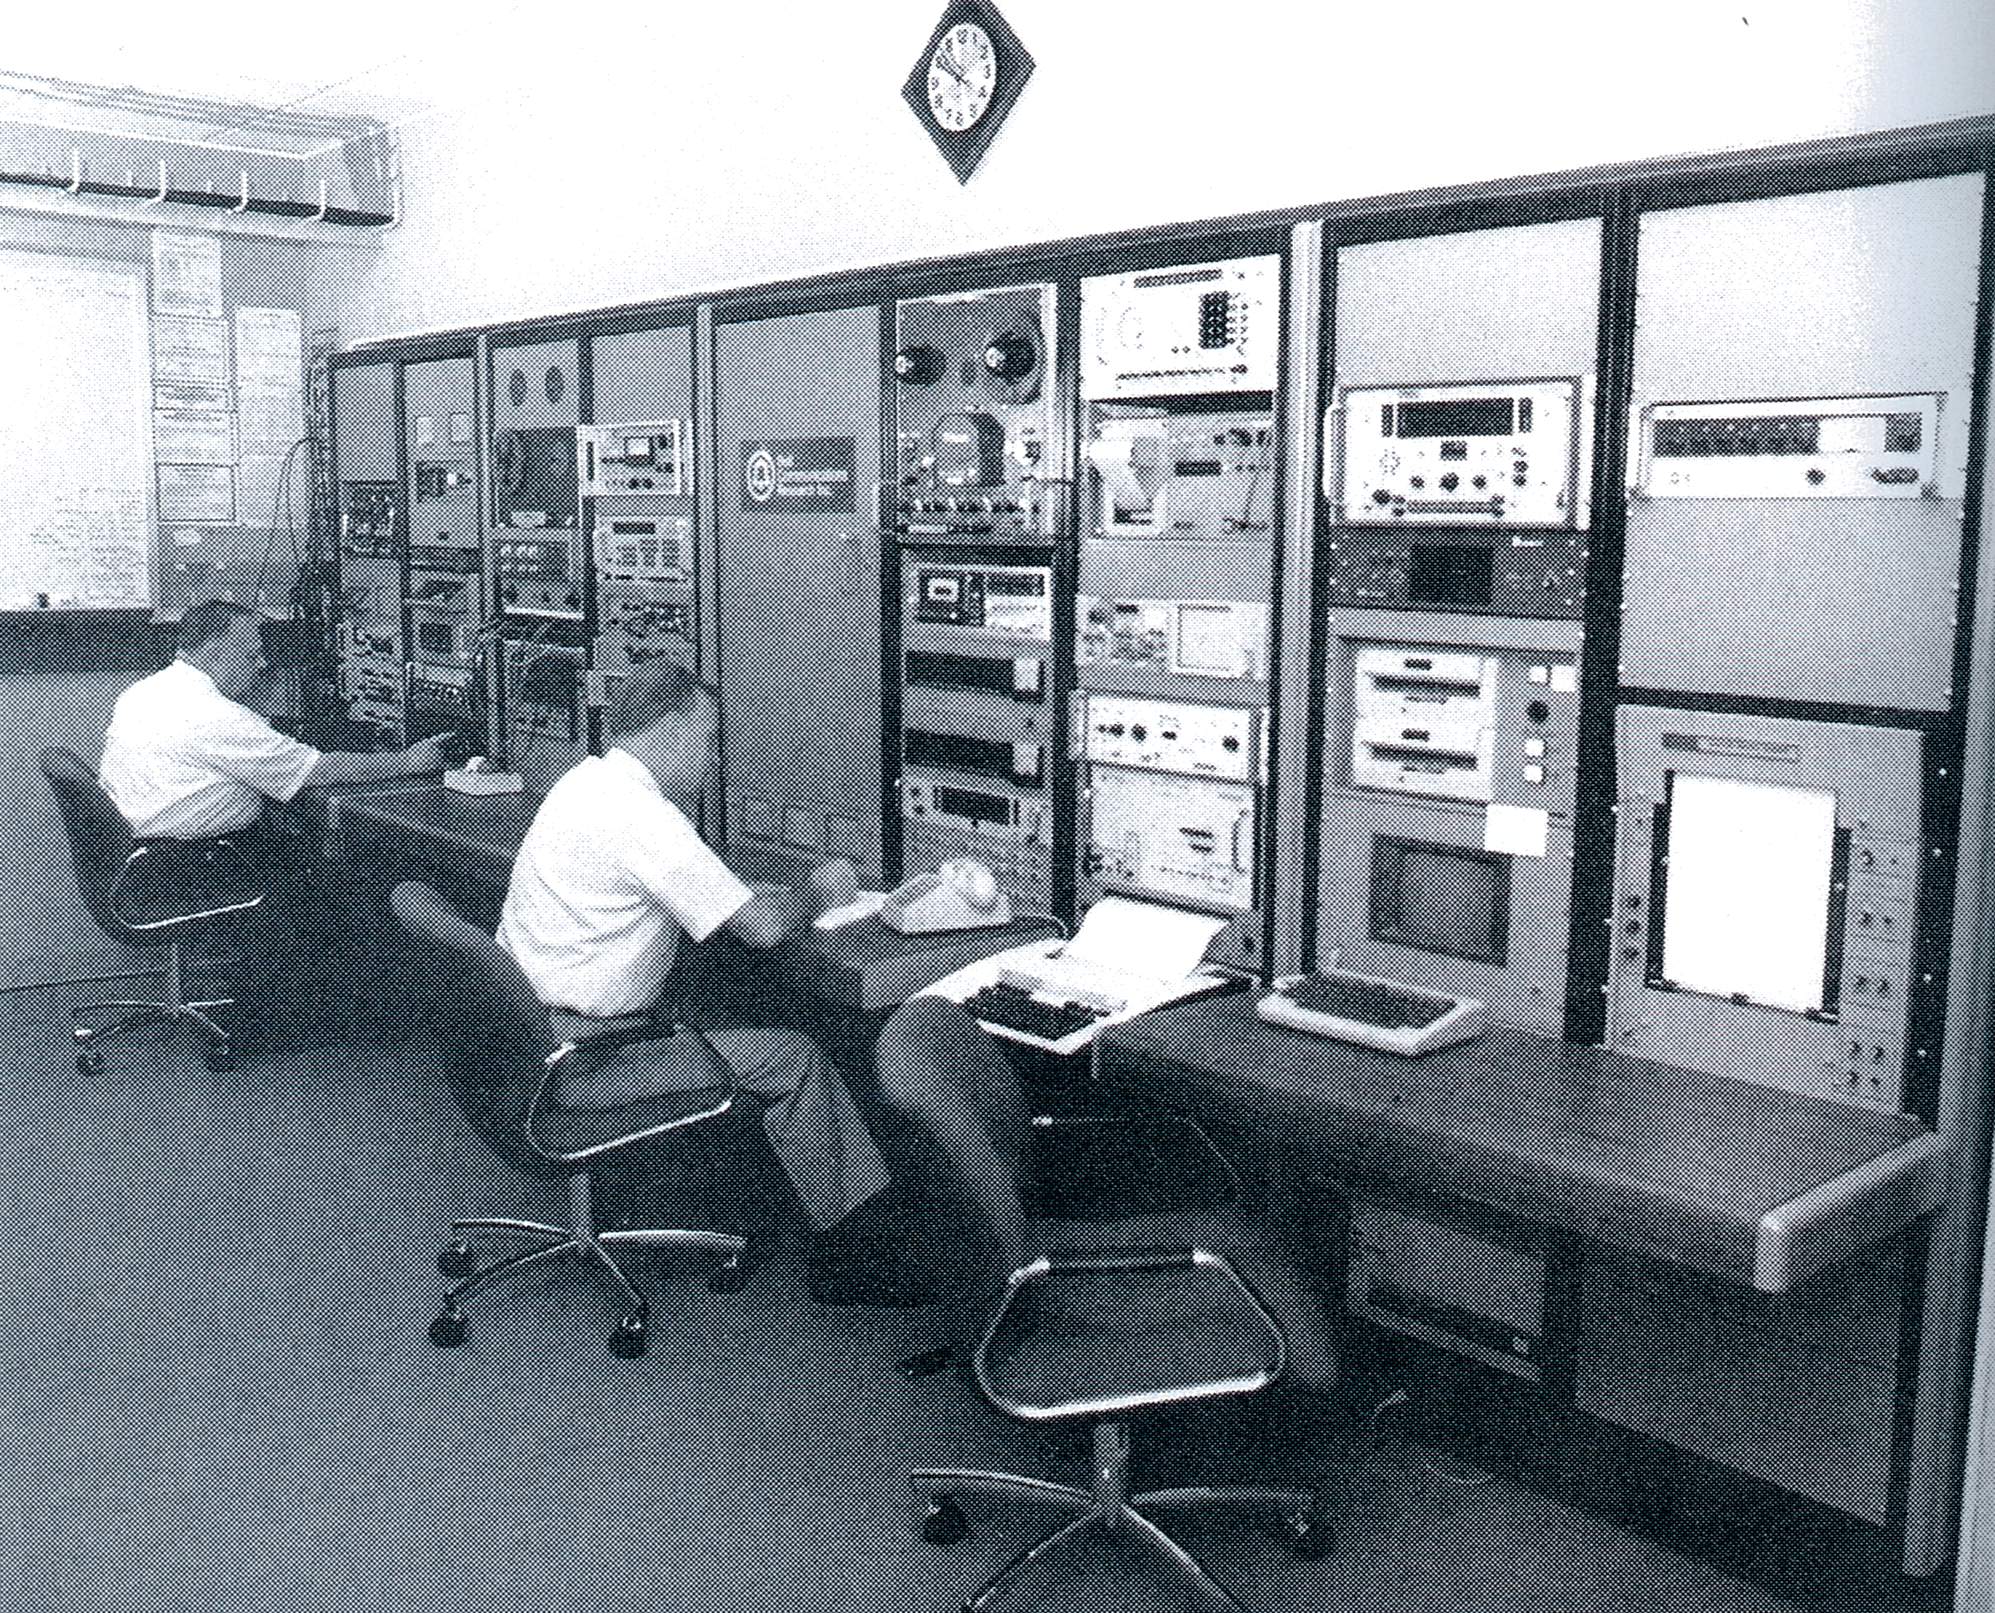
Notes:
1.5 million records came to this site, Telephone Crime Lab. Used sparingly for parallel construction. Used to prosecute bookies, who worked for the mob.

Slide 51
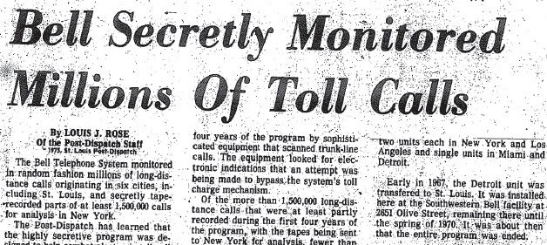
1975: The Story Breaks
Notes:
Investigations into corporate/executive-level corruption brought the wrath of god down on AT&T.
DoJ, SEC
February 2, 1975
http://blog.historyofphonephreaking.org/2013/06/
Greenstar, the AT&T toll fraud surveillance system that randomly monitored some 33 million American phone calls -- and recorded 1.5 million of them -- between 1964 and 1970.
"A single Greenstar unit would be connected to a hundred outgoing long-distance trunk lines and could simultaneously monitor five of them for fraud. [...] At its core, Greenstar looked for the presence of 2,600 Hz on a trunk line when it shouldn't be there. [...] When Greenstar detected something unusual, it took an audacious next step: it recorded the telephone call. With no warrant and with no warning to the people on the line, suspicious calls were silently preserved on spinning multitrack real-to-reel magnetic tapes." (p. 93)

Slide 52
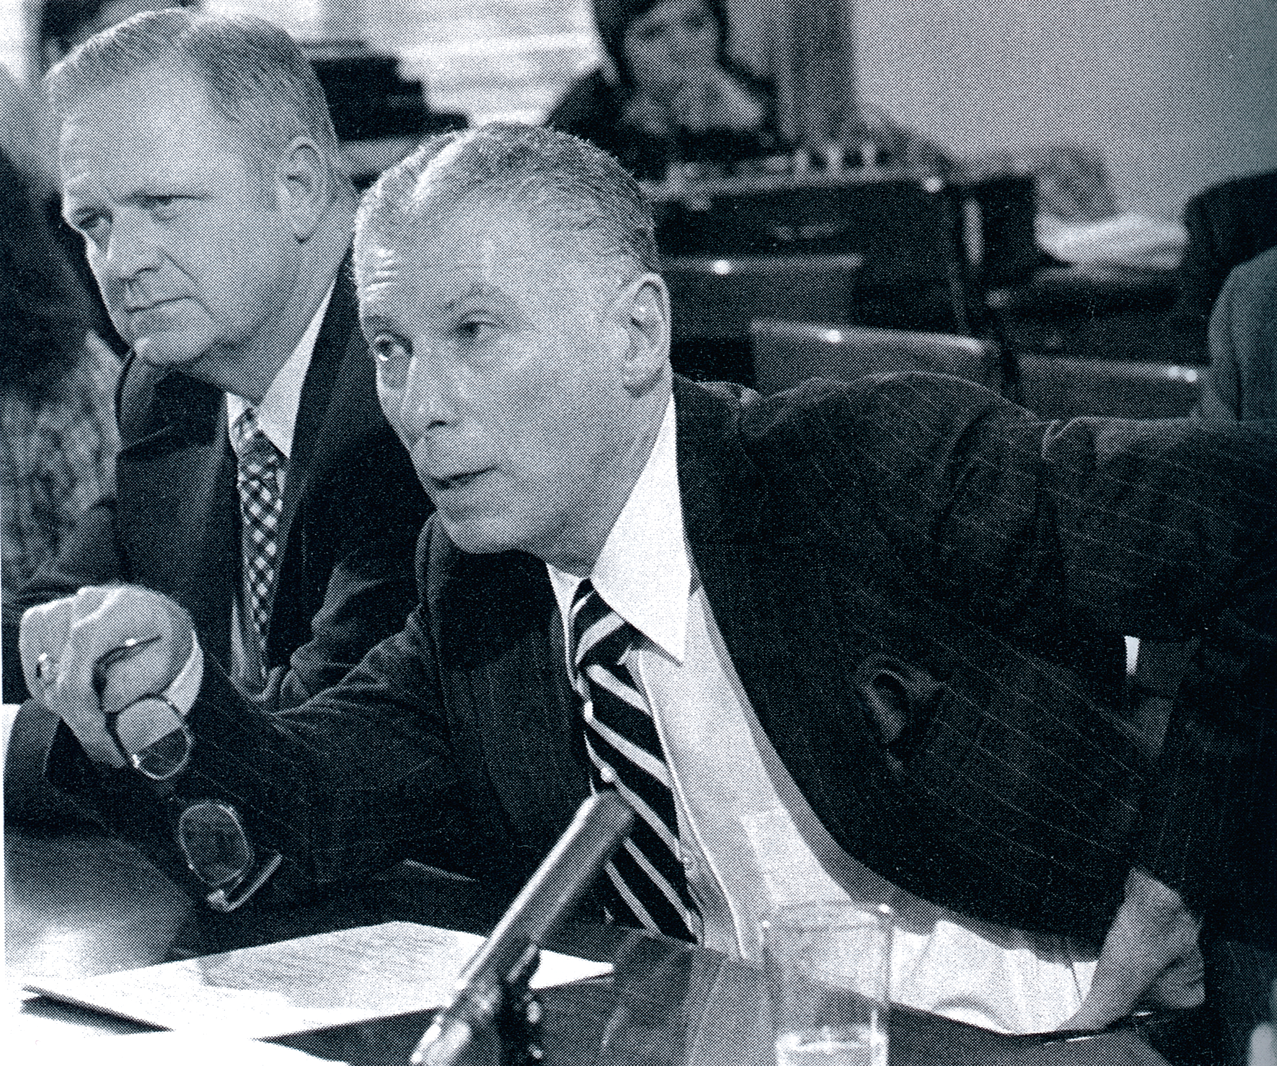
Notes:
Caming, who had known about it for 10 years, spoke non-stop during three-hour hearing. Caming explained AT&T's motivations for launching the surveillance system, how it operated, and, most important, why it was legal -- indeed, not just legal, but in fact the only option AT&T had to combat blue box and black box fraud at the time. AT&T managed to weather the Greenstar storm without much damage. Despite some alarming headlines there was little fallout and no criminal investigation. The Greenstar matter quickly faded away.
Before 1968, the federal wiretapping law was Section 605 of Title 18 of the United States Code did not make wiretapping ("interception") itself illegal. Rather, to commit a crime under Section 605 you had to both intercept a communication and then disclose the contents of the communication to someone else. Clearly when Greenstar recorded a call and a human listened to it, there was an interception, but because the trained operator listening to the tapes never discussed the contents of the communication (just the signaling of the call itself), there was no disclosure, and thus, AT&T asserted, no crime. In 1968 the Omnibus Crime Control and Safe Streets Act became the new law that governed wiretapping -- but that law had specific carve outs for random monitoring and interception of communications by telephone company personnel attempting to protect the assets of the telephone company.
Went away.

Slide 53
An Emerging Community
Capitol: Los Angeles
Chat Rooms:
Non-working numbers
Loop-arounds
Socially engineered “conferences”
Joke lines

Slide 54
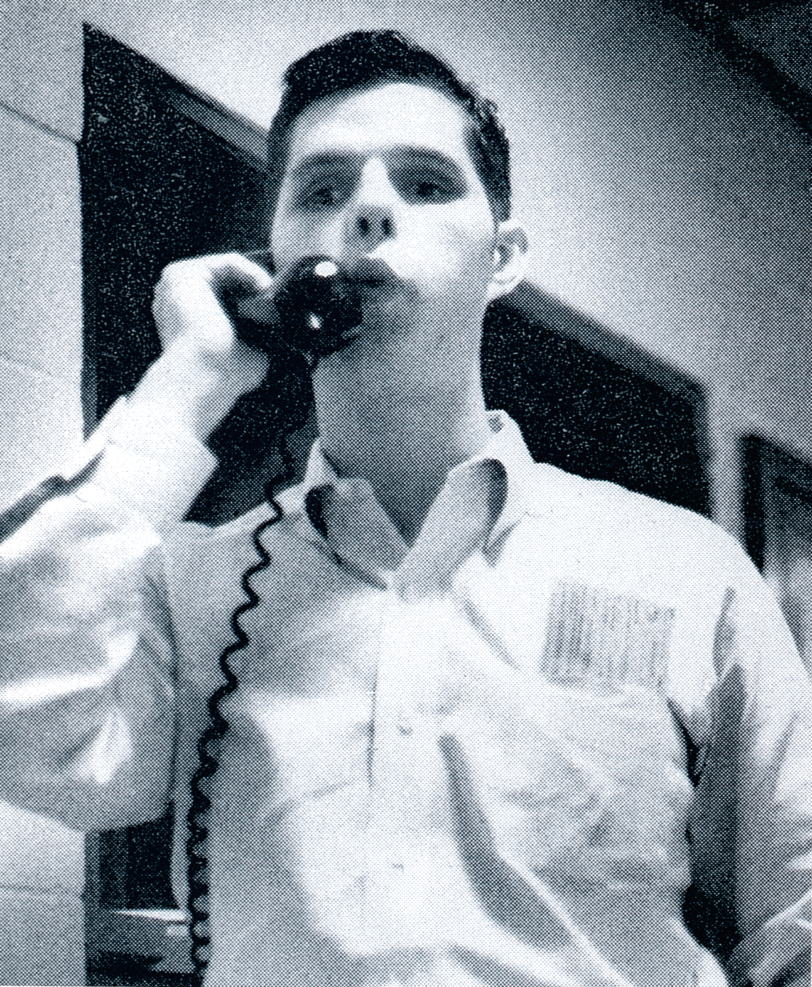
Joe Engressia “The Whistler”
Notes:
Engressia started when 8. Came from poor, rough home, and loved the telephone in a special way.
Became the whistler after a bet he made in college at U of south florida.
Caught: making a call for someone, whistled wrong and got a suspicious operator who recorded the call. Heard all about whiz kid who whistled free calls.
Company didn’t press charges, but was suspended from school temporarily.
Became famous.
Didn’t enjoy school, left a year early. Had trouble getting a job. Desperate, called US Embassy in Moscow, NORAD on a priority circuit.
Hauled in for a trial. Played a tape of him speaking to an operator. “Wait, he gave his own number, you know who he called, and you know how long he talked – why didn’t you just bill him??” Reduced to two charges of malicious mischief. $10 fine, sixty days in jail – suspended. Got four job offers that week.

Slide 55
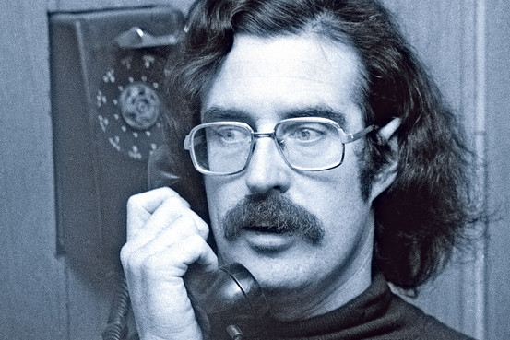
John Draper “Cap’n Crunch”
Notes:
http://si.wsj.net/public/resources/images/RV-AJ520_BKRV_P_G_20130201022723.jpg
Radio engineer in the Air Force. Running a pirate radio station, ran into Denny Teresi, another blind phreak, who also ran a pirate station and they became friendly. Teresi taught him about whistling, asked him if he could build them a blue box.

Slide 56
The 2111 conference
Core group:
Joe Engressia
John Draper
Bill Acker
Denny Teresi
Mark Bernay
Jim Fettgather
Notes:
2111 Vancouver line, many used to dial out of. Became non-working, but was configured in such a way that if multiple people dialed in – conference call!

Slide 57
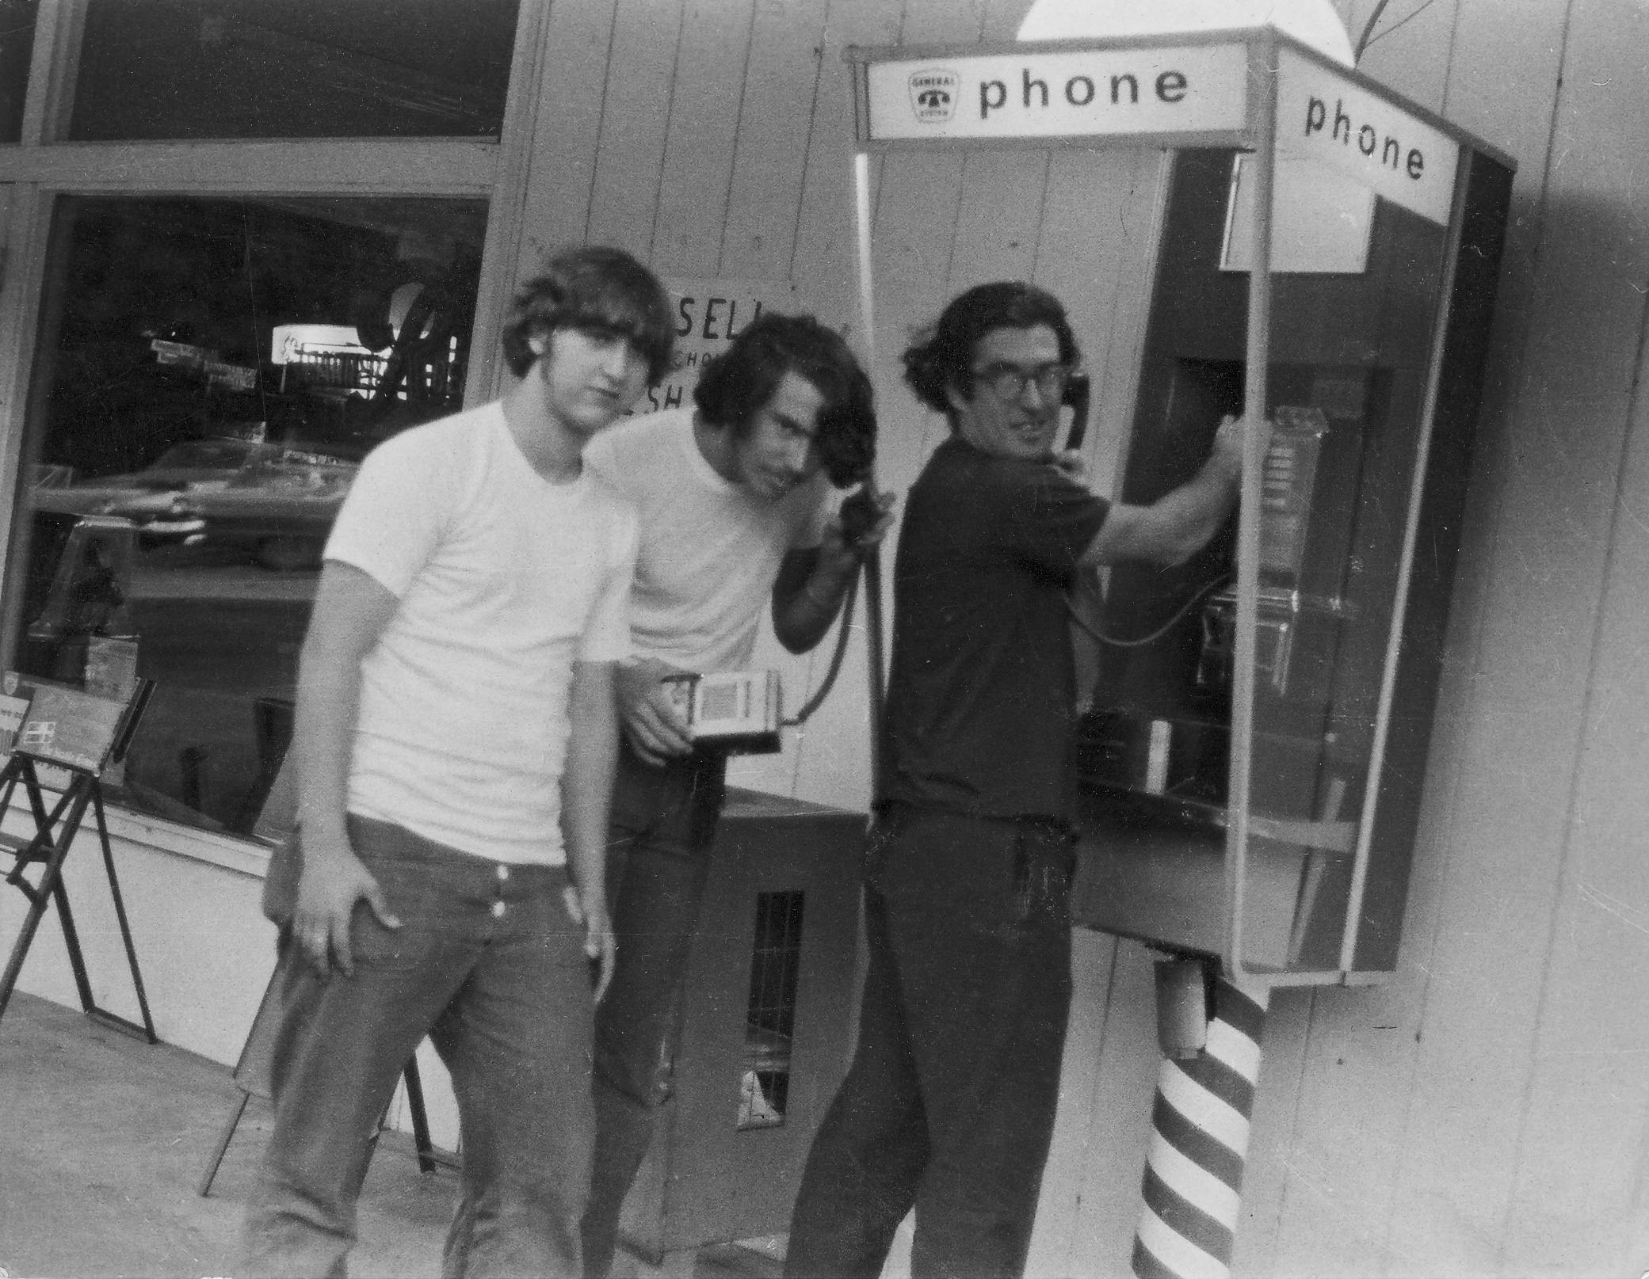
The Phone Phreaks of America

Slide 58
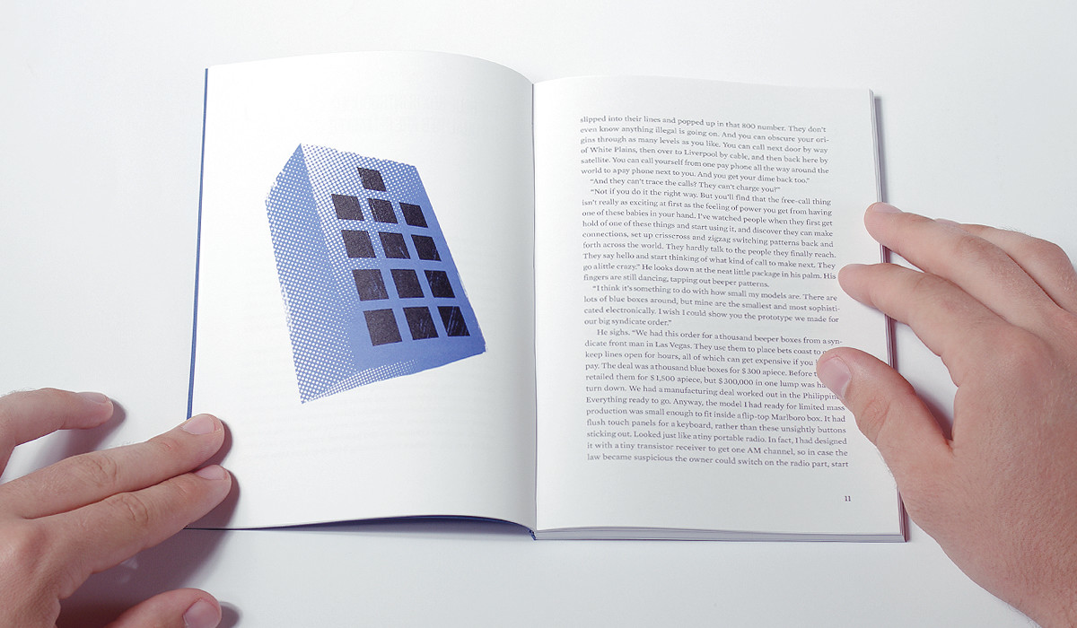
“Secrets of the Little Blue Box”
Esquire, 1971
Notes:
Gilbertson caught selling blue boxes out in SF. PPoA reached out.
Gilbertson was pissed about being caught when it was the phone company that had made the mistake.
Had his lawyer call up Esquire.
http://jakubfoglar.com/wp-content/uploads/2014/09/jf-secrets-box.jpg

Slide 59
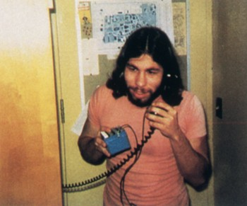
Steve Wozniak “Berkeley Blue”

Slide 60
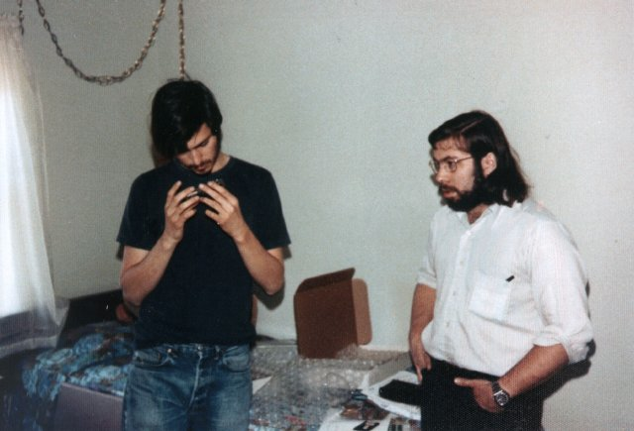
Steve Jobs “Oaf Tobar”
Notes:
http://paulgraham.com/bluebox.html
Credit: Margaret Wozniak in 1975

Slide 61
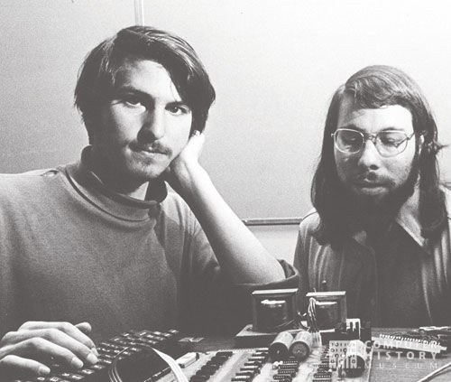
Business Venture
Notes:
http://www.maximumpc.com/files/u112496/two_steves_and_apple_1.jpg

Slide 62

Business Venture
Notes:
http://www.maximumpc.com/files/u112496/two_steves_and_apple_1.jpg

Slide 63
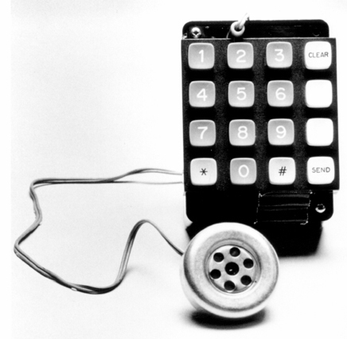
Business Venture
Notes:
Had business selling BB for $170 each. Came with paper from Woz, “The power of the world is in your hands,” repair warranty. Sold about 30-40.
Some of their clients were caught, many boxes seized, all had that paper – but they never traced it back.
http://www.maximumpc.com/files/u112496/two_steves_and_apple_1.jpg

Slide 64
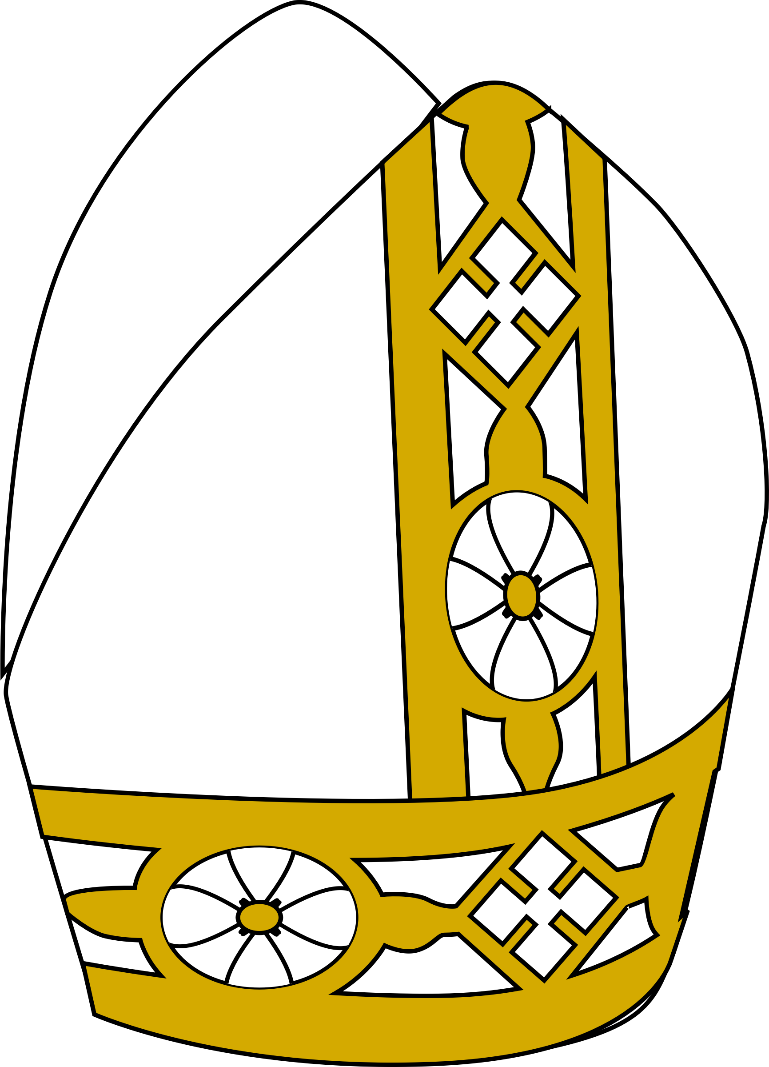
Pranks
Pope Party
Notes:
Wozniak called up the Vatican, pretended to be Henry Kissinger. ‘Ve are at the summit meeting in Moscow, and we need to talk to de Pope.’ Was told the Pope was sleeping, but they would send someone to wake him. Call back in an hour.
“Okay we will put the Bishop on, who will be the translator” “Dees is Mr. Kissinger” “Listen, I just spoke to Mr. Kissinger an hour ago.”

Slide 65
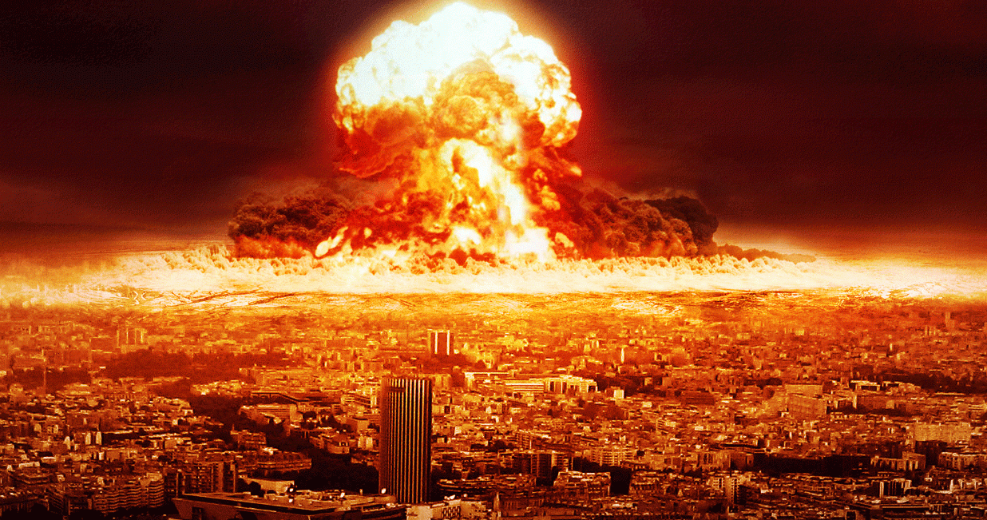
Pranks
Santa Barbara nuclear event
Notes:
Nov 10, 1974. 30 min prank where out of town callers into Santa Barbara were told There has been a nuclear explosion in Santa Barbara and all the telephone lines are out.
“Simultaneous seizure” – two people try to call through old stepwise equipment called a tandem switch. Both callers try to seize a circuit at the same time, are connected. Can do w/parallel wires. One person doesn’t hang up.

Slide 66

Pranks
Nixon’s toilet paper
Notes:
Carson
Draper
Olympus, please
What’s going on – We have a crisis here in Los Angeles! – What’s the nature of the crisis? – We’re out of toilet paper, sir! – Who is this?

Slide 67
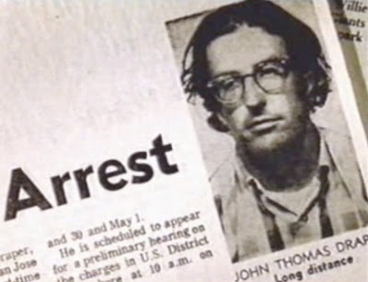
Draper’s Many Arrests
Notes:
The 2111 conference machine was shut down by the company, but not before they noticed and taped a long illegal conference call. Traced back to Draper. Seven counts of fraud by wire.
Later was arrested after a lengthy FBI investigation that he brought on himself by wiretapping an FBI line with his blue box and telling it to an FBI informant Four months of jail and five years probation.
Afterwards, went to work for Wozniak at Apple. Make computerize phone phreak
After that, threw a party where he demoed a phone phreaking computer, hauled away in cuffs.
A wiretap also caught him dialing illegally. Arrested again.
Then he blew a tire traveling a day after Christmas. His car was impounded and searched, and they found a blue box but let him go.
Sentenced to serve 3-6 months in jail for possession of a computer that would steal telecomm services. Once released, had to deal w/feds, b/c violation of his probation. Sentenced to spend nights in jail for a year, worked on EasyWriter for Apple. Sent open letter to phreak magazing TAP that said he’d moved on.

Slide 68
Engressia and Acker
Acker charged with conspiracy to commit fraud by wire
Charges dropped
Companions convicted
Engressia becomes network troubleshooter for Mountain Bell
Quits so they can hire Acker
Notes:
After reporting a bunch of bugs, Engressia ended up working in Denver for Mountain Bell as a network troubleshooter.

Slide 69
AT&T Split
1984, AT&T to be broken into 8 companies
- AT&T can keep Bell Labs
- Can go into computers
1976, network upgrade to CCIC begins
- Modem-like ability enabled by transistors
Notes:
Common channel interoffice signaling

Slide 70
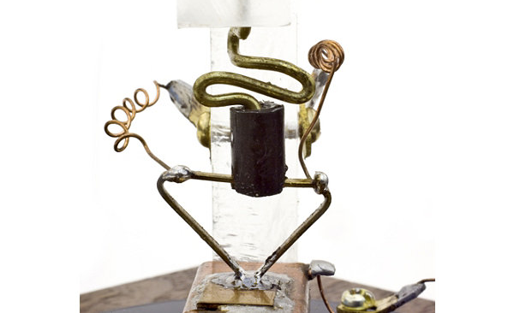
The Age of the Transistor
Notes:
By the mid 80s, the original playground was gone. Though phone phreaking still continues in other forms, the age of the transistor had begun.

Slide 71
Final Remarks

Slide 72
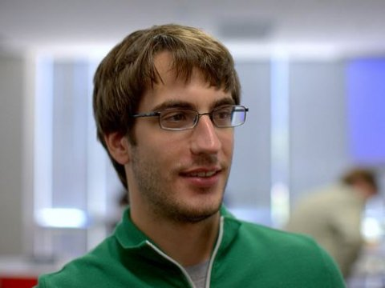
Jeff Hammerbacher
Notes:
Businessweek 2011
wrote analytics suite on top of hadoop
http://static3.businessinsider.com/image/4d5c68634bd7c8071e030000-480/jeff-hammerbacher-of-cloudera.jpg

Slide 73
Jeff Hammerbacher
"The best minds of my generation are thinking about how to make people click ads.”
Notes:
I’ve seen this first hand. <examples>
I think in many ways Silicon Valley culture sucks a lot and the social and political trends caused by the technology we are building is genuinely frightening
As department we don’t do a good job of exposing you to cypherpunks, hacktivists, and counterculture.
I want to change that. I want to remind you that as engineers we are uniquely poised to build the future we want to live in.
Businessweek 2011
wrote analytics suite on top of hadoop
http://static3.businessinsider.com/image/4d5c68634bd7c8071e030000-480/jeff-hammerbacher-of-cloudera.jpg

Slide 74

Notes:
Here’s to the crazy ones.
The misfits, the rebels, the troublemakers.
They change things. They push the human race forward.

Slide 75
